Slide 1
Chapter 28

Slide 2
28-1
List the types of substances to which each of the following chromatographic methods is most applicable:
Gas-liquid Ans: Species that are somewhat volatile and thermally stable (有些揮發性和熱穩定性的物種)
Liquid adsorption Ans: Nonpolar low to moderate molecular mass organics and particularly isomeric organic species (非極性低至中等分子量有機物，特別是異構有機物種類)
Liquid-liquid partition Ans: Molecular species that are nonvolatile or thermally unstable. (非揮發性或熱不穩定的分子種類)
Reverse-phase partition Ans: Most low to moderate molecular mass organic compounds that are nonvolatile or thermally unstable. (大多數低至中等分子量的有機化合物，非揮發性或熱不穩定)

Slide 3
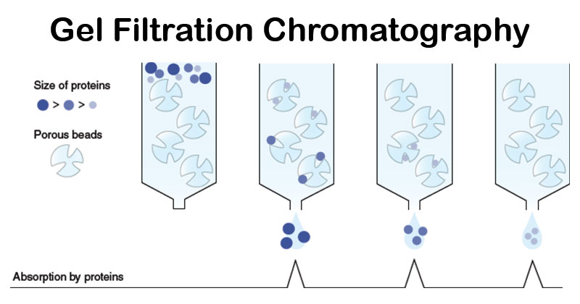
Ion exchange Ans: Substances that are ionic or that can be derivatized to form ions.(離子或可衍生形成離子的物質)
Gel permeation Ans: High molecular mass compounds that are soluble in nonpolar solvents. (可溶於非極性溶劑的高分子量化合物)
Gas-solid Ans: Low molecular mass nonpolar gases. (低分子量非極性氣體)
Gel filtration Ans: High molecular mass hydrophilic compounds. (高分子量親水化合物)
Ion-pair Ans: Small organic and inorganic ions. (小的有機和無機離子)
固定相膠體為疏水性質，稱為膠體滲透層析(gel permeation chromatography, GPC)；親水性者則稱作膠體過濾層析(gel filtration chromatography, GFC)。移動相一般為液體，若層析時需要外加電壓產生
電場，則稱電泳(electrophoresis)
https://microbenotes.com/gel-filtration-chromatography/

Slide 4
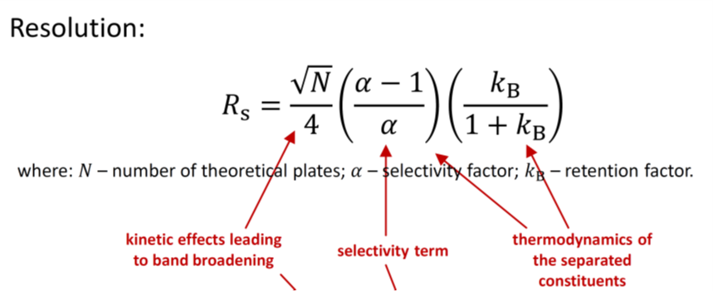
28-2
Describe three general methods for improving resolution in partition chromatography
Adjustment of k_{A} and k_{B} by employing a multicomponent mobile phase and varying the ratio of the solvents to find an optimal mixture. (通過使用多組分流動相並改變溶劑的比例以找到最佳混合物來調節k_{A}和k_{B})
Variation in the chemical composition of the solvent system in such a way as to make α larger. (溶劑體系的化學組成的變化，使α變大)
Employing a different packing in which α is greater. (採用α更大的不同填料)

Slide 5
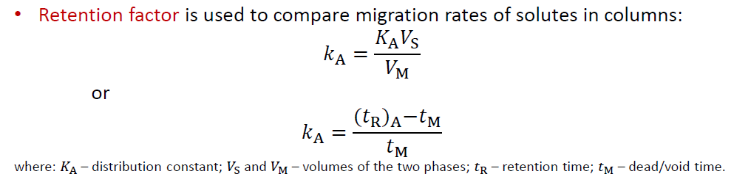
28-3
Describe a way to manipulate the retention factor of a solute in partition chromatography.
In partition chromatography, k is conveniently varied by using a two (or more) component solvent system and varying the ratio of the solvents (描述一種在分配色譜中操縱溶質保留因子的方法。使用兩種（或更多種）組分溶劑系統並改變溶劑的比例，可方便地改變k)

Slide 6
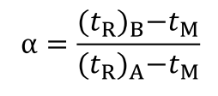
Question 28-4
How can the selectivity factor be manipulated in (a) GC and (b) LC?
In gas chromatography, α is generally varied by varying the column packing
In LC, both column packing and chemical composition of the mobile phase can be varied to yield better α values.

Slide 7
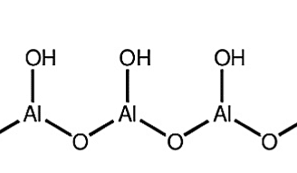
Question 28-5
In preparing a hexane-acetone gradient for an alumina HPLC column, is it desirable to increase or decrease the proportion of hexane as the column is eluted?
Stationary phase: alumina packing polar
Hexane nonpolar
Acetone polar
increase the polarity of the mobile phase as the elution proceeds
proportion of hexane should decrease
沖提能力應由小至大，也就是說動相與固相之差異由大到小。

Slide 8
Question 28-6
What is meant by the linear-response range of a detector?
range of analyte concentration or mass over which the detector responds linearly
linear-response range = dynamic range

Slide 9
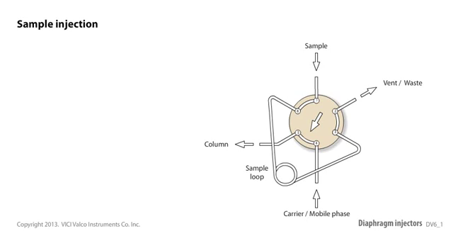
Question 28-7
Define:
isocratic elution
the solvent composition is held constant throughout the elution
gradient elution
two or more solvents are used and the composition of the mobile phase is changed continuously or in steps as the separation proceeds
stop-flow injection
the flow of solvent is stopped, a fitting at the head of the column is removed, and the sample is injected directly onto the head of the column. The fitting is then replaced and pumping is resumed.
https://www.youtube.com/watch?v=8-D-mMfDw7g

Slide 10
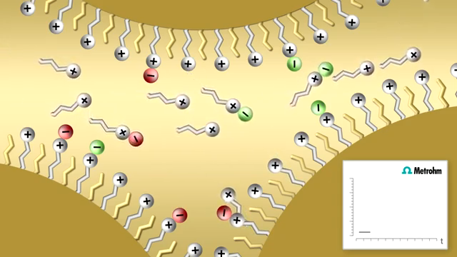
Question 28-7
Define:
reversed-phase packing
a nonpolar packing that is used in partition chromatography with a relatively polar mobile phase
normal-phase packing
the stationary phase is polar and the mobile phase is relatively nonpolar
ion-pair chromatography
Ion-pair chromatography allows one to separate ionic species on reversed-phase columns.
a large organic counter-ion is added to the mobile phase as an ion-pairing reagent.
separation is achieved either through partitioning of the neutral ion-pair or as a result of electrostatic interactions between the ions in solution and charges on the stationary phase resulting from adsorption of the organic counter-ion.
注意與Ion-exclusion chromatography的差異

Slide 11
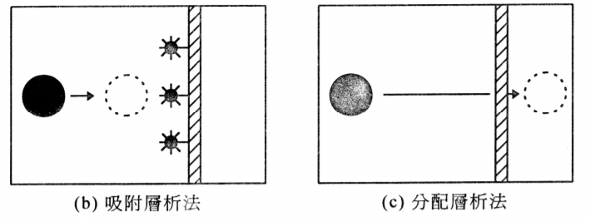
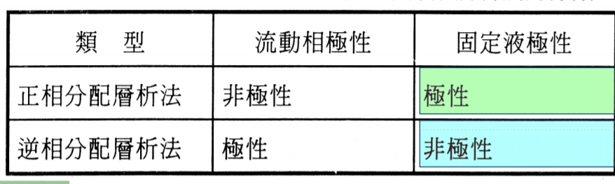
Question 28-9
In what way are normal-phase partition chromatography and adsorption chromatography similar?
Adsorption chromatography(吸附層析法):
利用樣品在吸附劑（固定相）上的吸附能力強弱不同而得以分離的方法，稱為吸附層析法。
Partition chromatography(分配層析法):
利用樣品在惰性固體上的液體（固定相）中溶解度不同 (即在二不互溶液體間之分配係數的差異)，以萃取法而達到分離稱為分配層析法。
Normal-phase partition chromatography和adsorption chromatography的相似之處在於兩者的固定相均為極性，而流動相為相對非極性。
file:///C:/Users/User/Downloads/Microsoft_PowerPoint_-_99-09-29%E5%B1%A4%E6%9E%90%E6%B3%95%E5%8E%9F%E7%90%86-1.pdf

Slide 12
Question 28-12
Describe the fundamental difference between adsorption and partition chromatography.
在adsorption chromatography中，分離是基於樣品成分與固體表面之間的吸附平衡。
在partition chromatography中，分離基於兩種不混溶液體之間的分佈平衡。

Slide 13
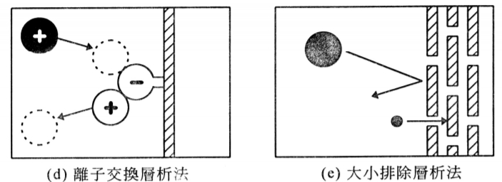
Question 28-13
Describe the fundamental difference between ion-exchange and size-exclusion chromatography.
Ion-exchange chromatography (離子交換層析法):
利用試料成分在離子交換樹酯(固定相)表面上之親和力的差異來進行分離的層析法。
Size-exclusion chromatography (大小排除層析法):
利用分子大小不同來分離，又稱分子篩層析法、凝膠滲透層析法。
在尺寸大小排除層析法中，基於分子的大小來分離，而固定相與樣品之間幾乎沒有相互作用。
在離子交換層析法中，基於固定相與流動相中樣品之間的離子交換反應來分離。
file:///C:/Users/User/Downloads/Microsoft_PowerPoint_-_99-09-29%E5%B1%A4%E6%9E%90%E6%B3%95%E5%8E%9F%E7%90%86-1.pdf

Slide 14
Question 28-14
What types of species can be separated by HPLC but not by GC?
GC所分析的樣品只限於氣體和沸點較低的化合物，它們僅占有機物總數的20%。對於占有機物總數近80%的那些高沸點、熱穩定性差、分子量大的物質，目前主要採用HPLC進行分析。
HPLC 優點:
高速、高效、高靈敏度、高自動化
HPLC 缺點:
儀器設備費用昂貴，操作嚴格

Slide 15
Question 28-17
Mass spectrometry is an extremely versatile detection system for GC. However, interfacing an HPLC system to a mass spectrometer is a much more difficult task. Describe the major reasons why it is more difficult to combine HPLC with mass spectrometry than it is to combine GC with mass spectrometry.
Mass spectrometry (質譜)需要氣相樣品。
LC管柱的輸出是溶解在溶劑中的溶質(液體)，而GC管柱的輸出是氣體，因此直接相容。
作為LC / MS的第一步，必須將溶劑蒸發。
Notes:
質譜是用於GC的功能極其廣泛的檢測系統。 但是，將HPLC系統與質譜儀連接是一項艱鉅的任務。 描述將HPLC與質譜結合起來比將GC與質譜結合起來更困難的主要原因。

